Slide 1
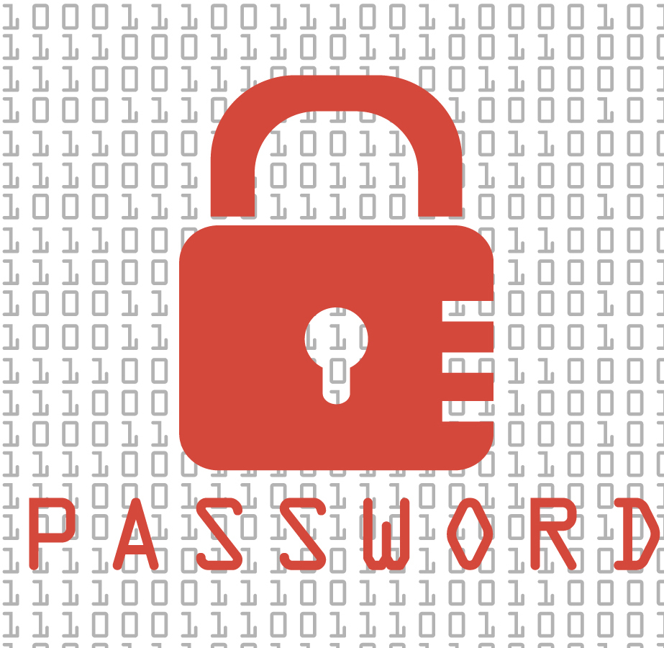
How to keep passwords safe
By M & J

Slide 2
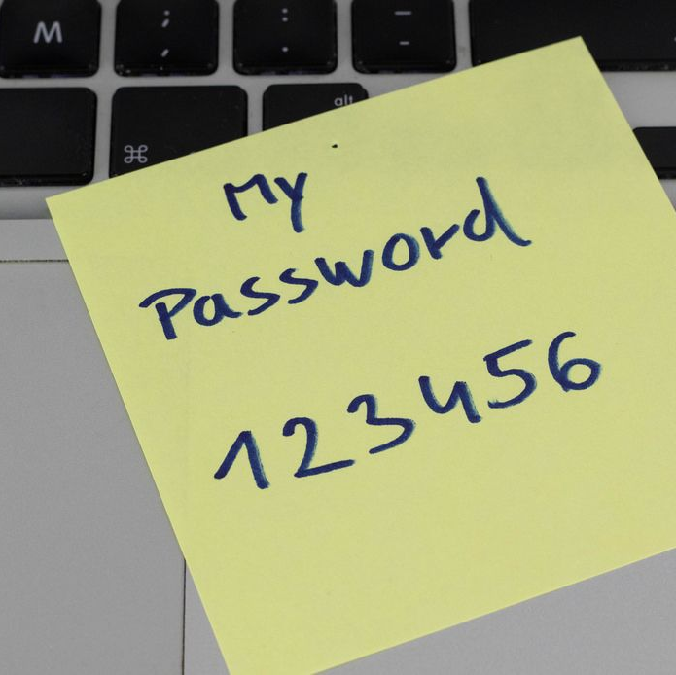
What not to do with your passwords!
Don’t write your password down on a random piece of paper, not in an email, not ANYWHERE!
Don’t reuse passwords across accounts.
Avoid using loved ones' names.
Avoid using memorable keyboard paths. An example would be 123456.
DO NOT TELL ANYONE YOUR PASSWORD!

Slide 3
Good words for passwords
Make sure you use...
Symbols
Upper case letters
Lower case letters
Ten or more characters total

