Slide 1
Private information

Slide 2
Games
When you are playing games with someone with a mic, you should never talk about your private info unless you take off your mic.
Don’t use the private information of others if they tell you, and if possible don’t listen.
NEVER TELL ANYONE ONLINE YOUR PRIVATE INFORMATION!

Slide 3
Emails
You use emails to communicate with others all across the world! It's important to keep your emails safe because, if someone was to log on to your account, they could send harmful messages to others. They could think you have said it, but you didn’t.
That’s why we have passwords and email addresses. Also, grown-ups could have banking details and if someone saw they/he/she could steel ALL your money!

Slide 4
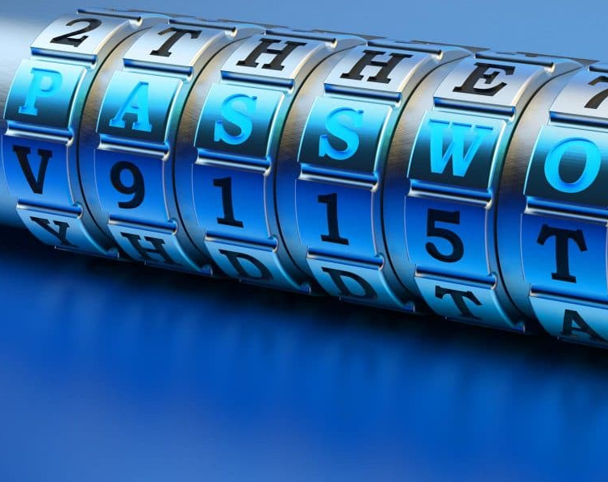
Passwords
Passwords are important because they keep your computer safe from being logged in to from other people. It's important not to share them with anyone! Thankfully, if someone puts in a wrong password repeatedly, your account will be locked.
They also keep all the rest of your private info on your device from being hacked by someone else.

Slide 5
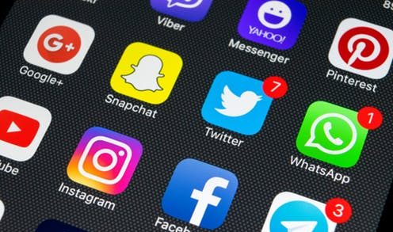
Social media
Social media platforms are a place to communicate with friends and post things that you have done.
Social media requires you to use a password to get into your account. They also have privacy settings so you can choose who gets to see your account and what information you want them to see.
Don’t post any of your private information because anyone could see it .
This Photo by Unknown author is licensed under CC BY-SA-NC.

Slide 6
Zoom
On certain calls or messages you can talk about your private information, such as those with family members or trusted adults
You have got to be careful in zoom calls because if you message your email address and go on your account, anyone could join any of your zoom calls.
This Photo by Unknown author is licensed under CC BY-SA.

