Slide 1
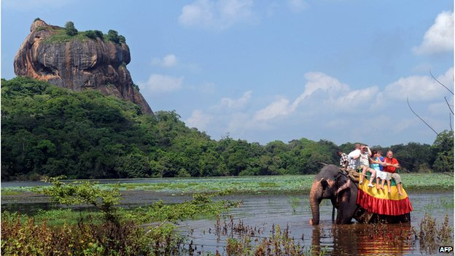
Sri Lanka

Slide 2
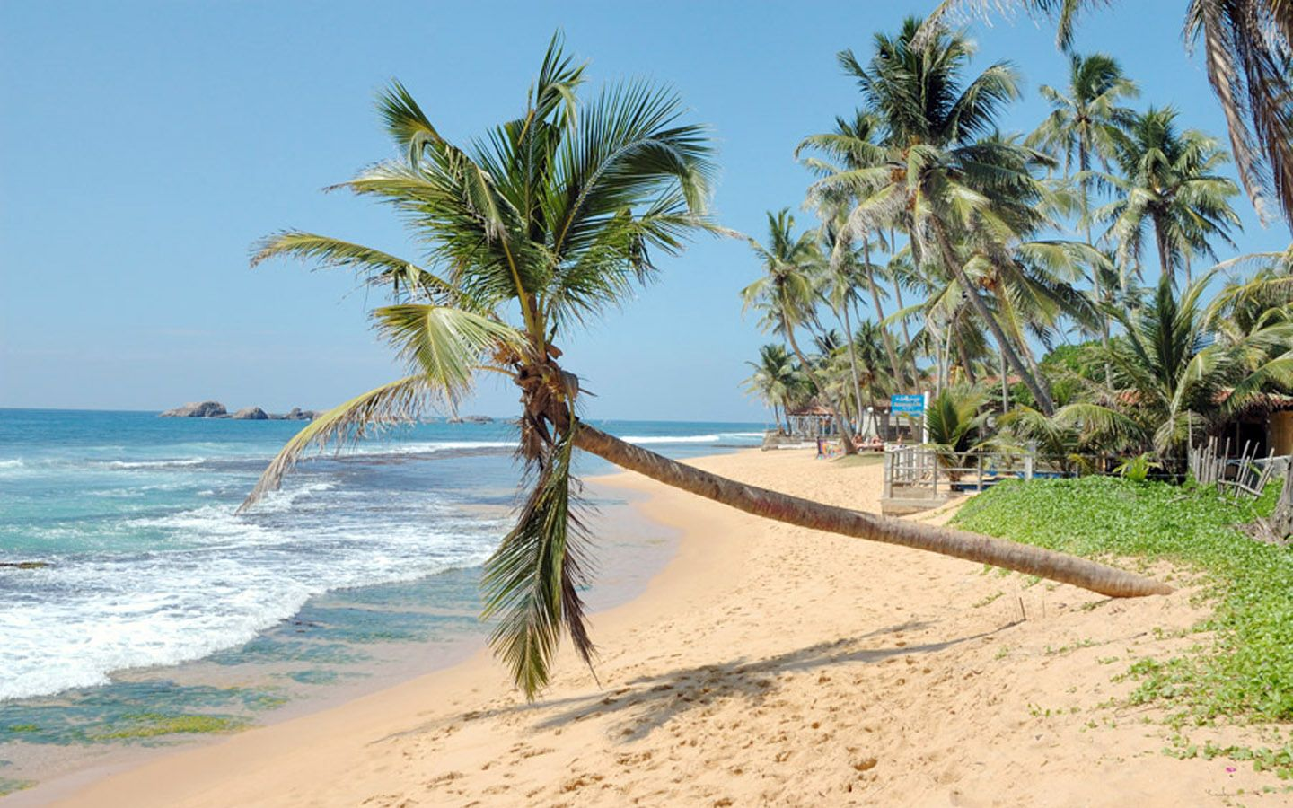
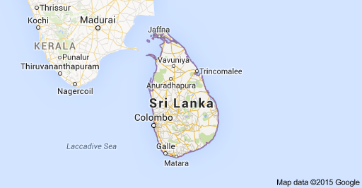
Where is Sri Lanka
Sri Lanka is an island near south-east India.

Slide 3
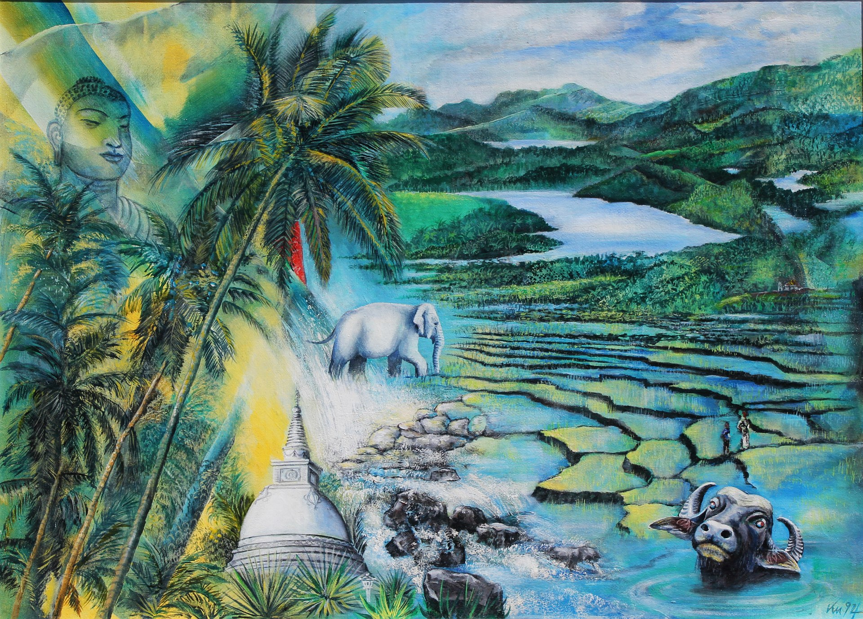
What is the capital of Sri Lanka?
The capital of Sri Lanka is Sri Jayawardenepura Kotte.

Slide 4
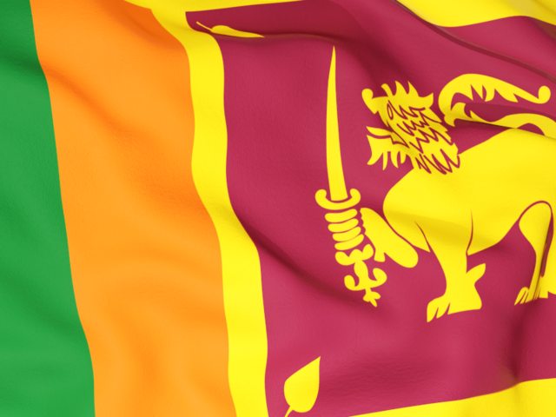
Which colours make up the Sri Lanka flag
A gold lion with a dark red background. A yellow background with two stripes one green and one orange.

Slide 5
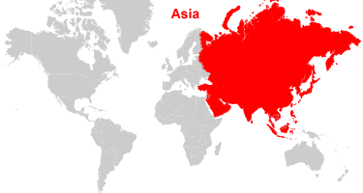
In which continent is Sri Lanka?
Sri Lanka is in Asia.

Slide 6
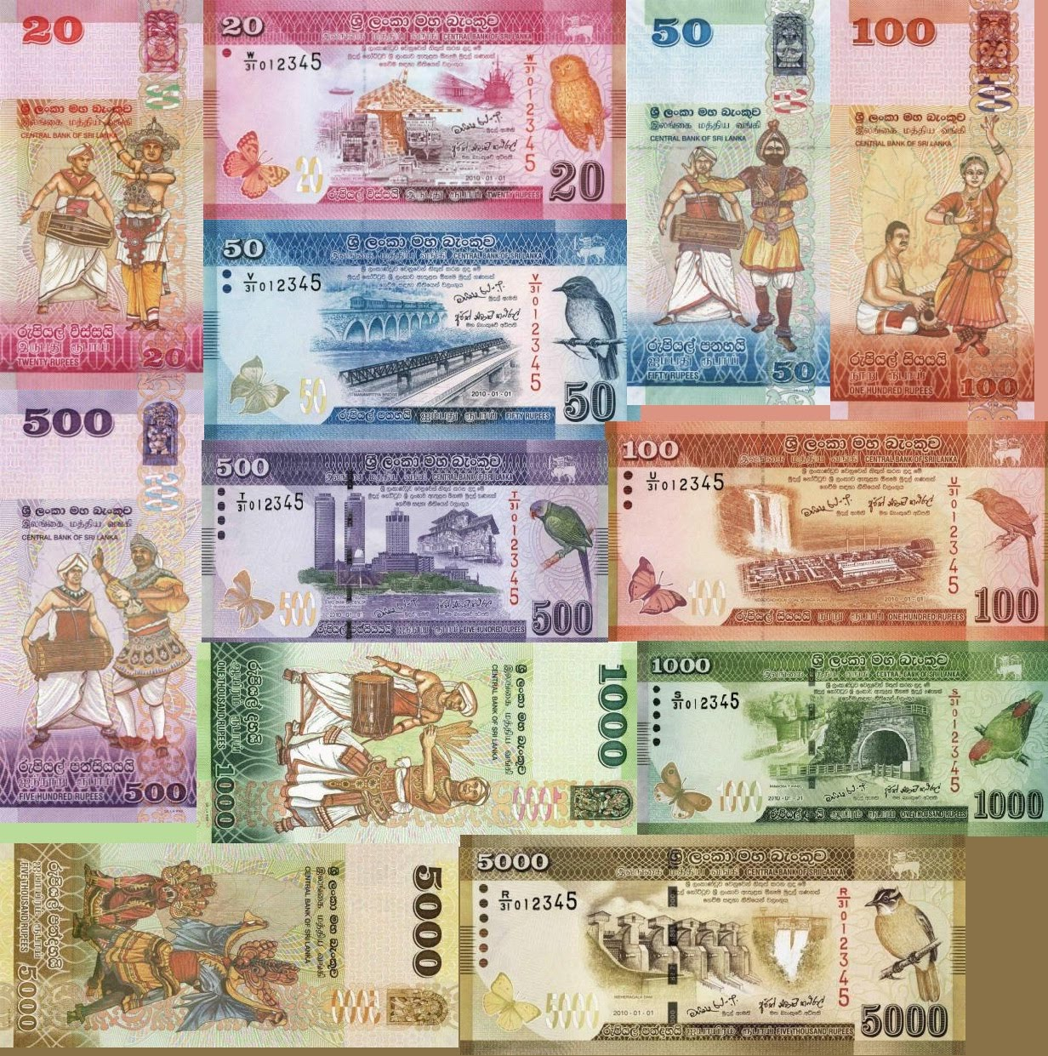
What is the Sri Lankan currency?
Rupee is the Sri Lankan currency.

Slide 7
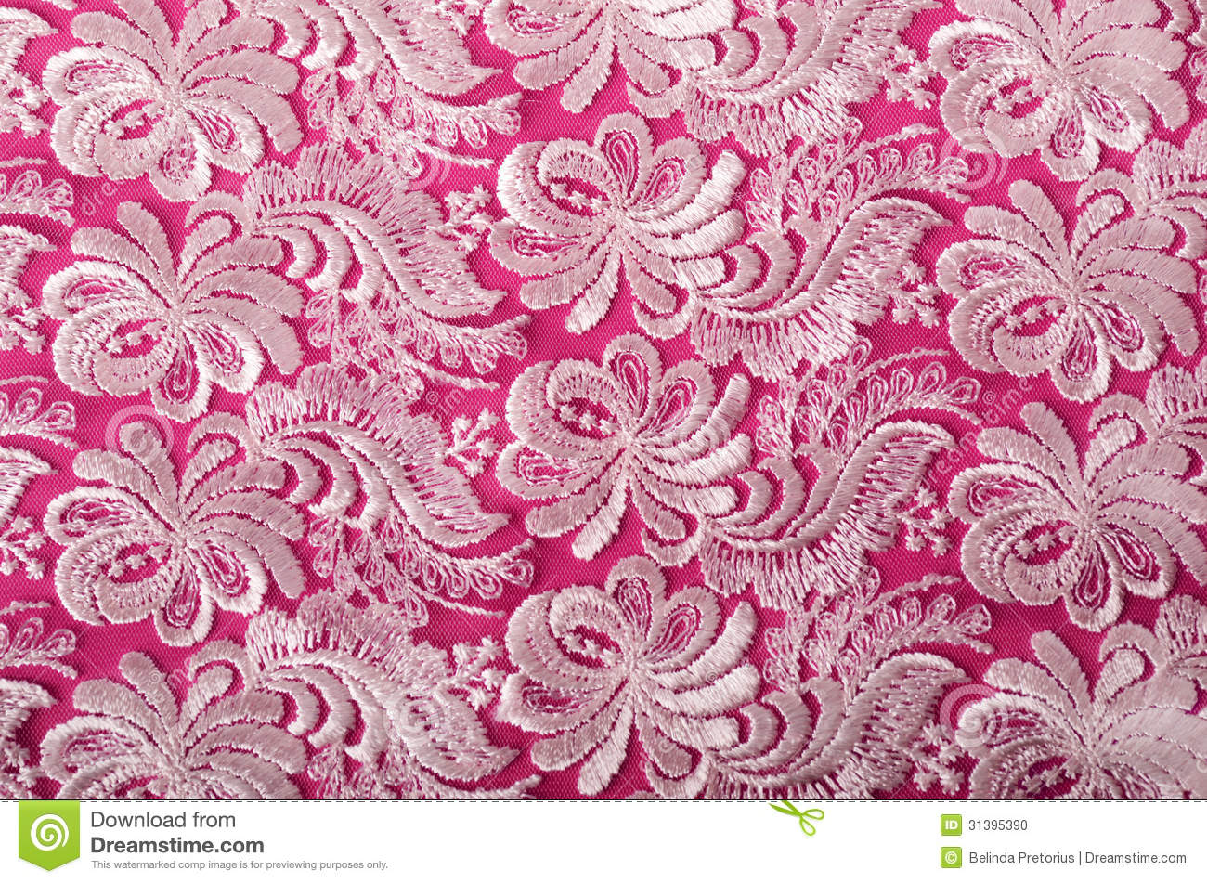
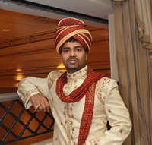
What is the Sri Lankan nation dress?
Men wear long sleeved shirts with a sarong. Women wear tight fitting, short sleeved jackets with a wrap around called a cheeththaya.

Slide 8
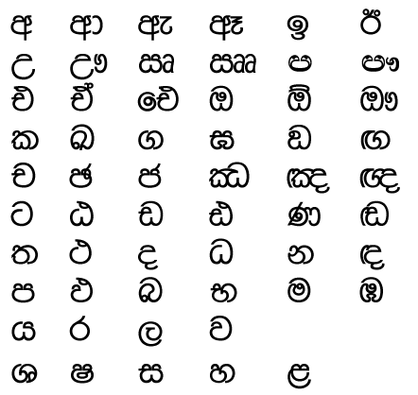
What is the official language in Sri Lanka?
Sinhala and Tamil are the official languages.

Slide 9
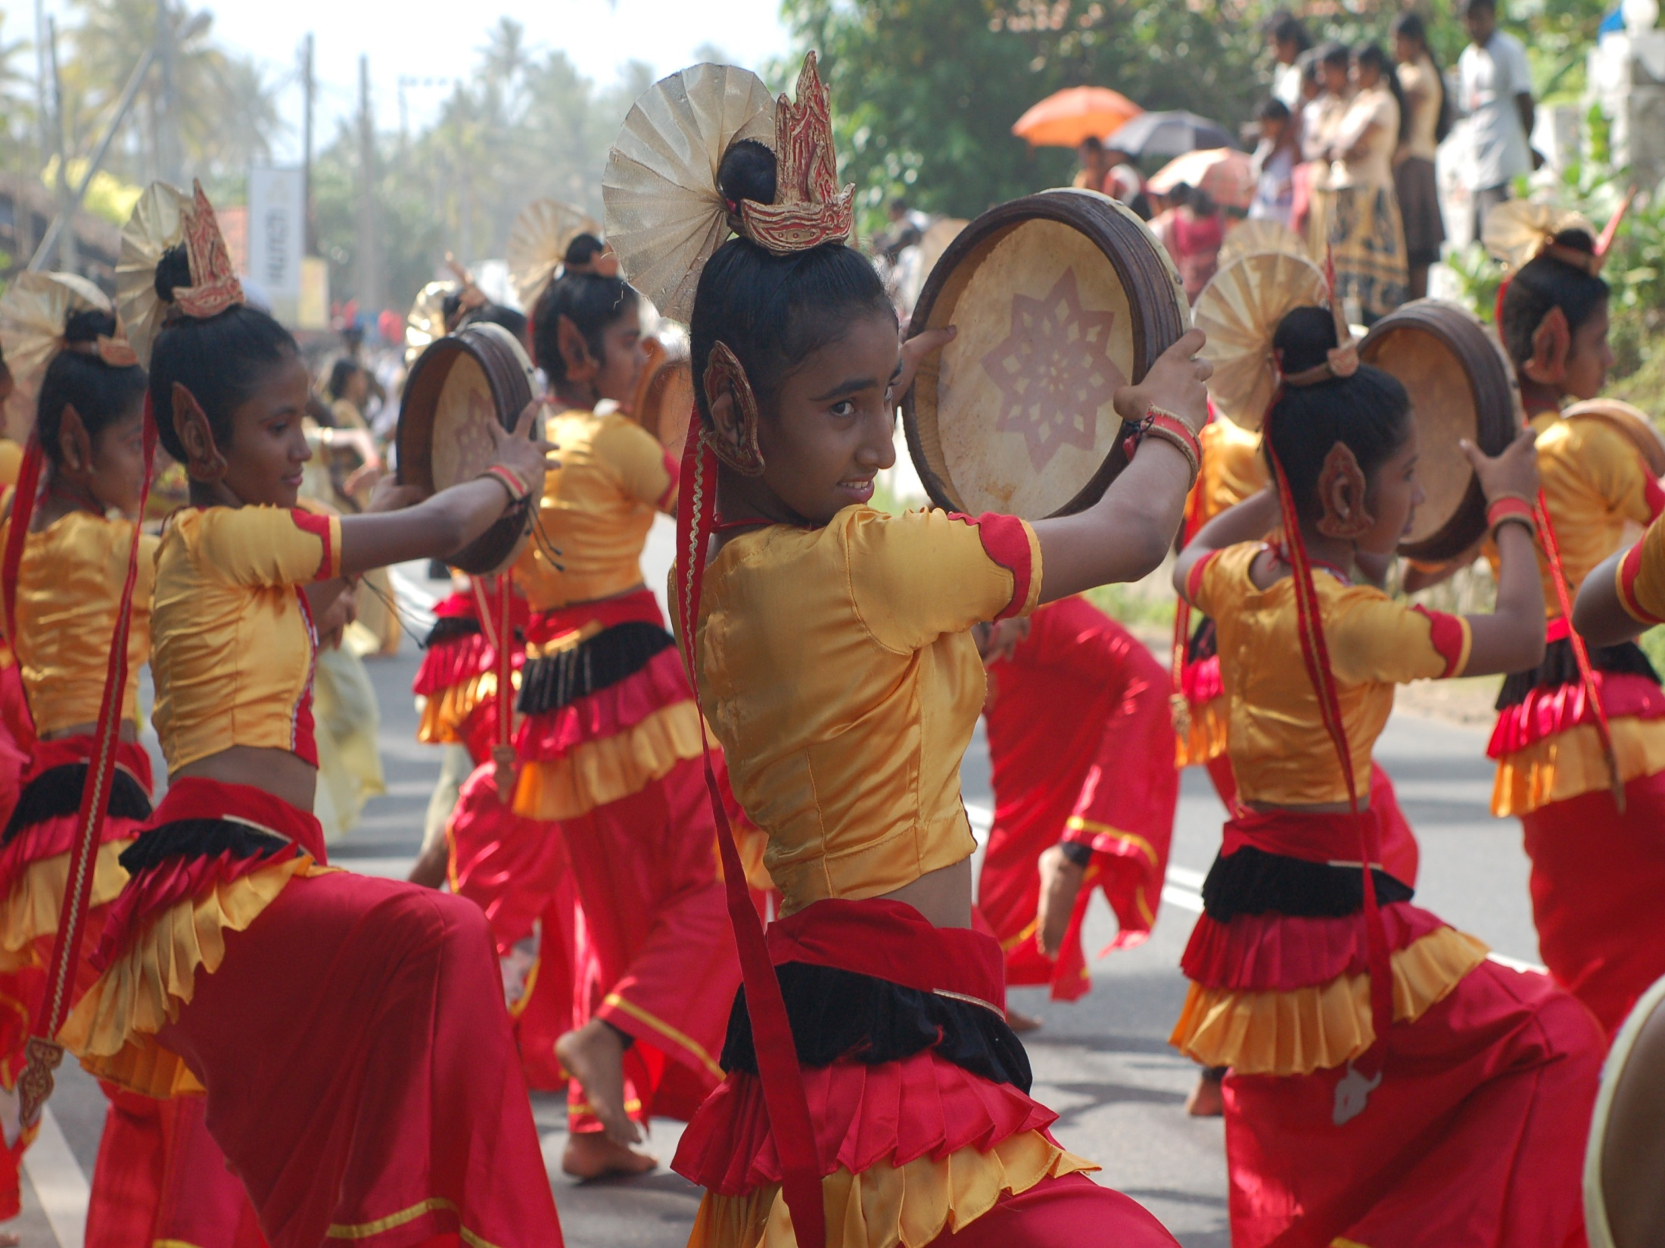
What is the population of Sri Lanka?
The population is 20.48 million.

Slide 10
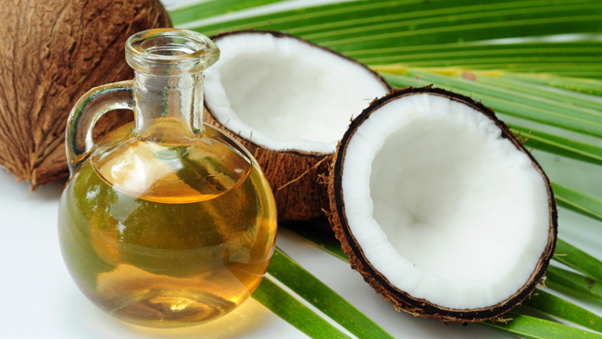
Which fibrous one-seeded drupe is used in many Sri Lankan dishes?
Coconut oil is mainly used in Sri Lankan dishes.

Slide 11
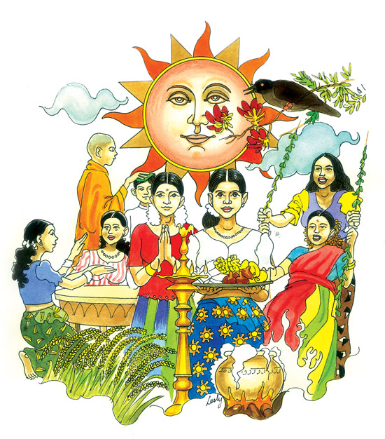
When is Sri Lankan New Year?
Sri Lanka’s new year is April 13th.

Slide 12
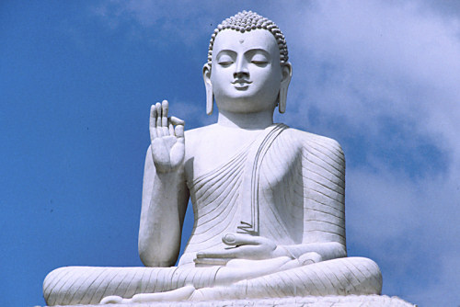
What are the main religions in Sri Lanka?
The main religion that Sri Lanka follow is Buddhism. Followed by Hinduism.

Slide 13
What is the most popular sport in Sri Lanka?
Cricket is the most popular sport in Sri Lanka.

Slide 14
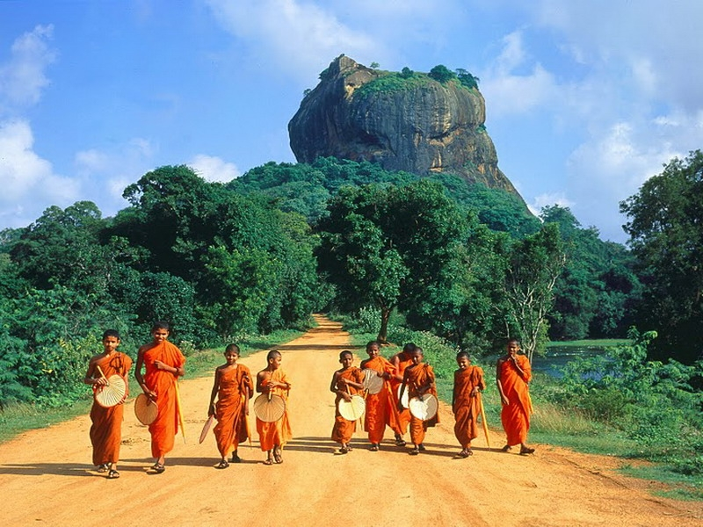
What was Sri Lanka formally known as?
Sri Lanka was formally known as Ceylon.

Slide 15
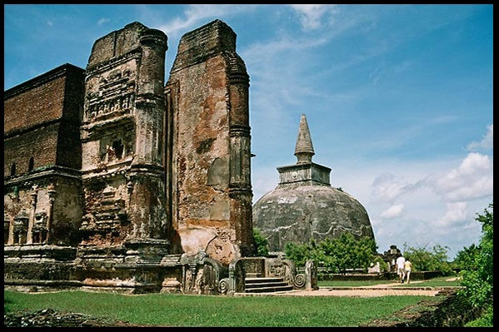
What year did Sri Lanka change it’s name?
1972

Slide 16
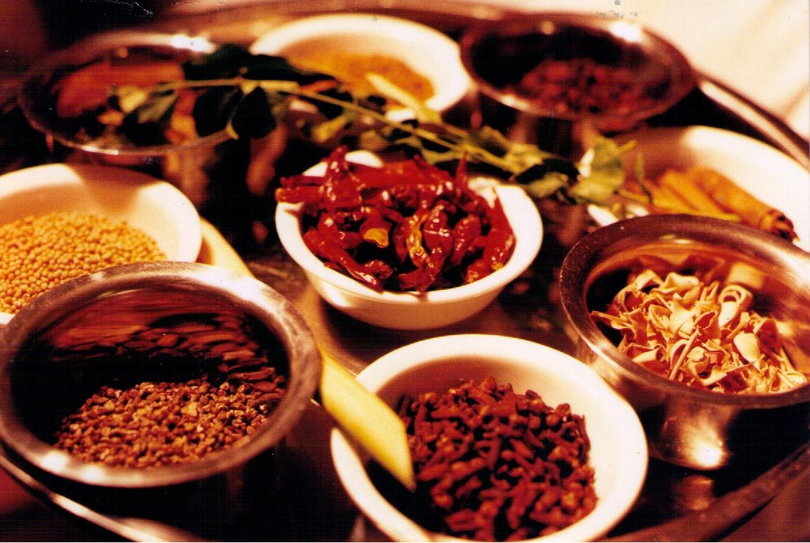
Which spice originates from Sri Lanka?
Sri Lanka is famous for cinnamon, pepper, cloves, cardamoms, nutmeg, mace and vanilla.

Slide 17
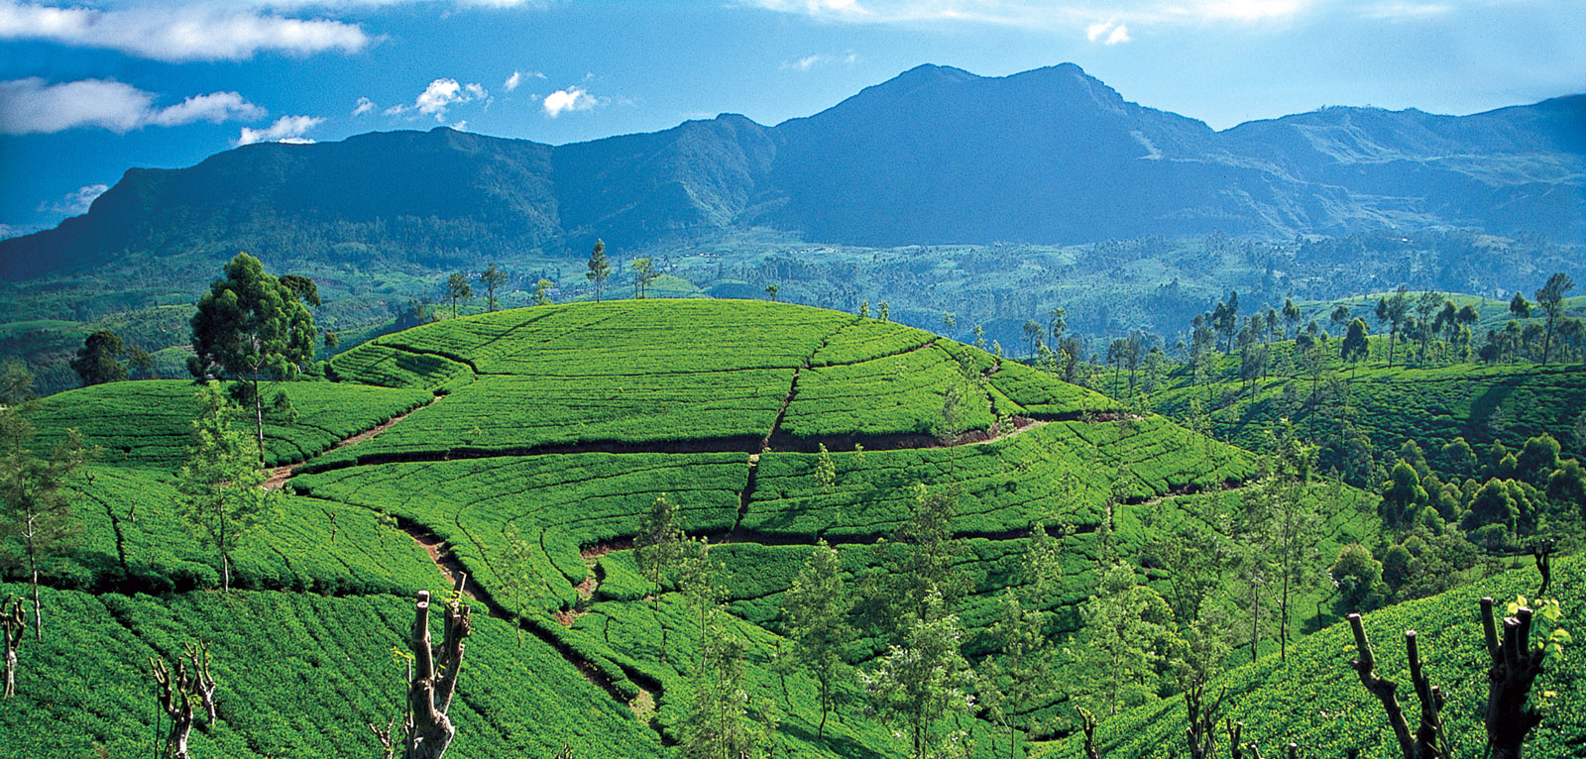
What is Sri Lanka’s biggest export?
Tea is the biggest export of Sri Lanka.

Slide 18
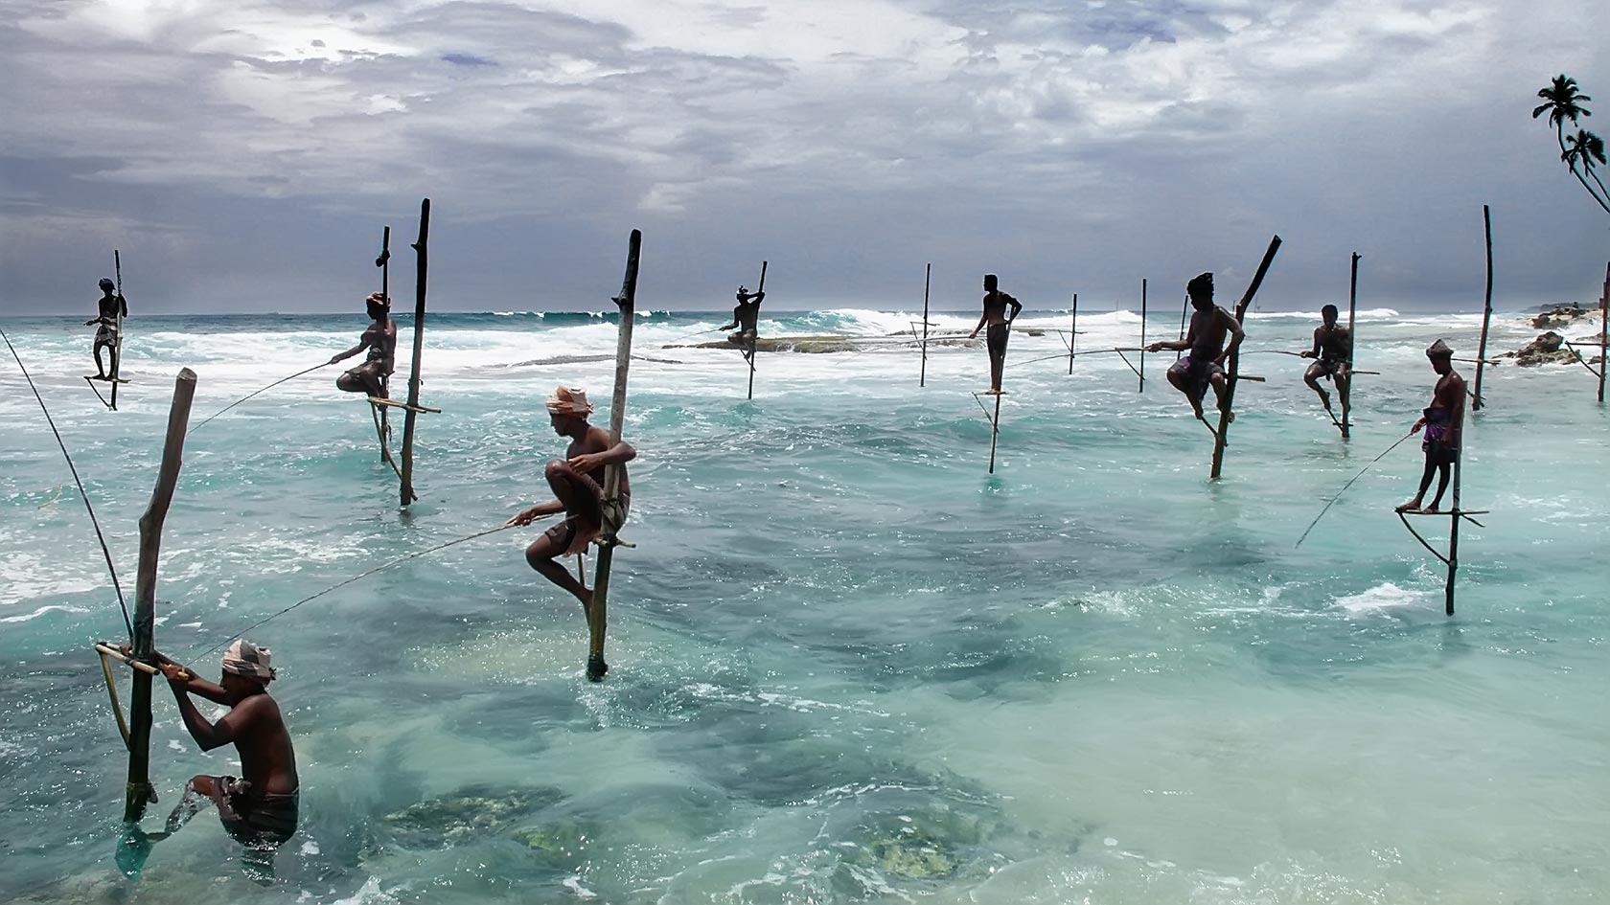
In which Ocean is Sri Lanka?
Sri Lanka is in the Indian Ocean.

