Slide 2
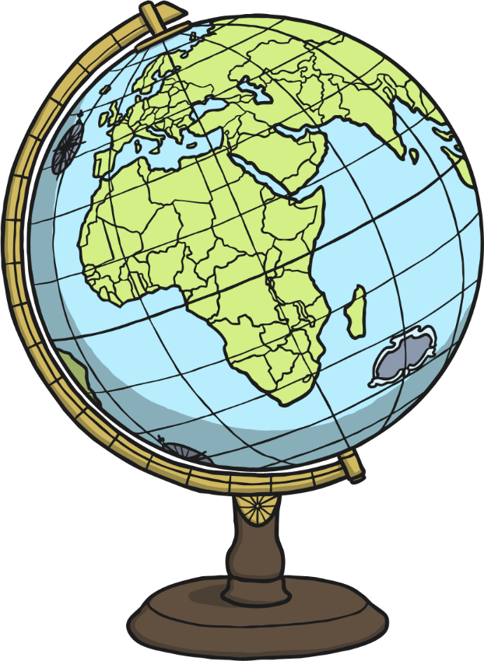
Aim
To learn about different aspects of China
Success Criteria
To be able to locate China on a map.
To understand what the climate is like.
To learn about the culture of the country.

Slide 3
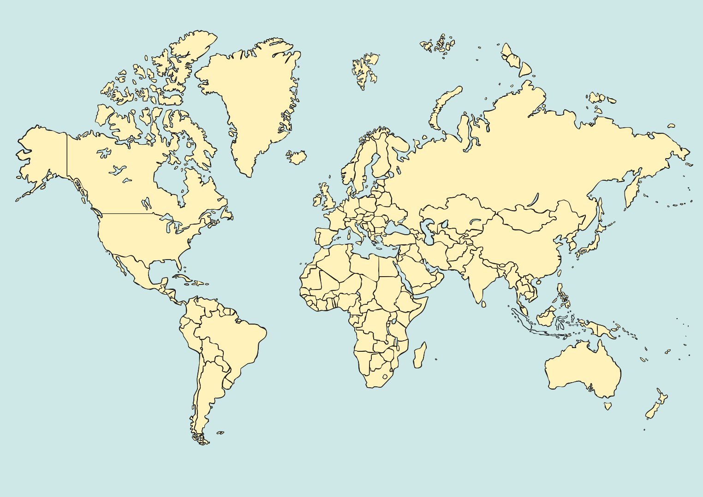
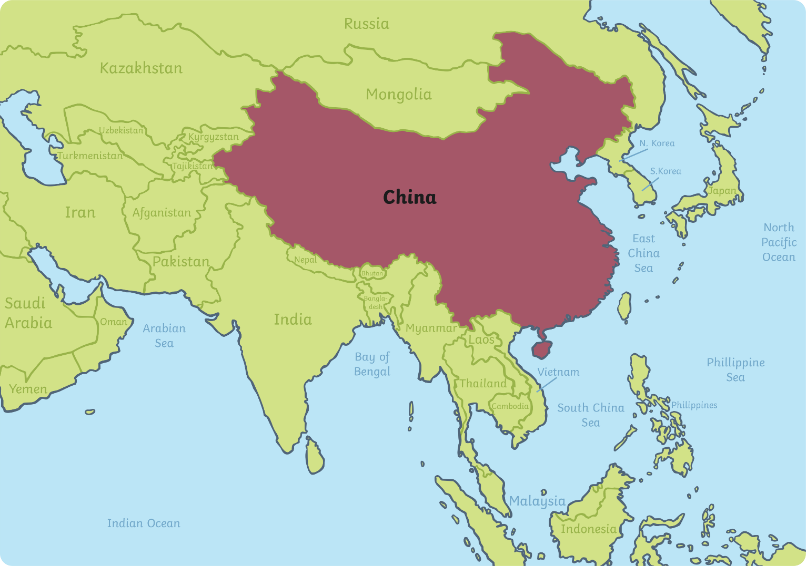
Where is China?
China is a country in East Asia
It is officially known as the People’s Republic of China
It is the world’s second largest country
Hong Kong was handed back over to China by the United Kingdom in 1997, June 30th

Slide 4
More about China
The capital city of China is Beijing
The largest city in China is Shanghai
China is the most populous country in the world with over 1.35 billion people living there
It contains the third and sixth longest rivers in the world, the Yangtze and Yellow rivers

Slide 5
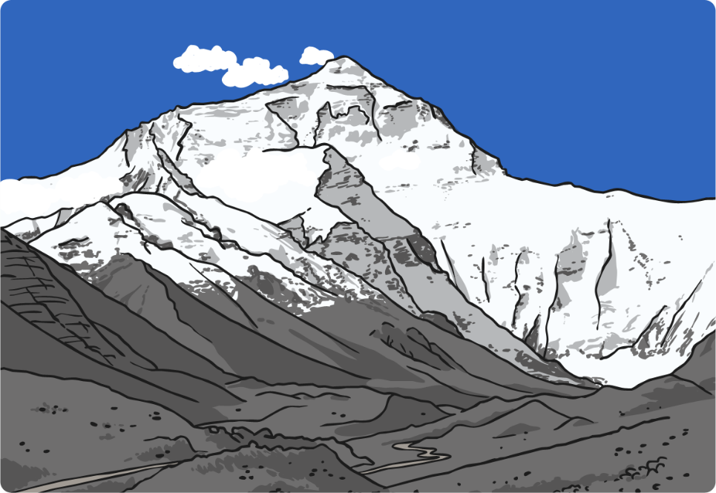
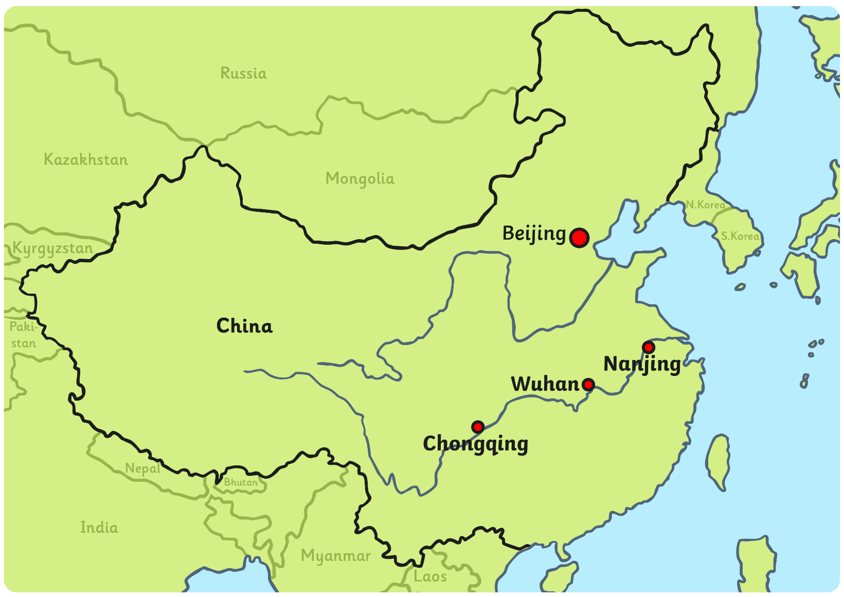
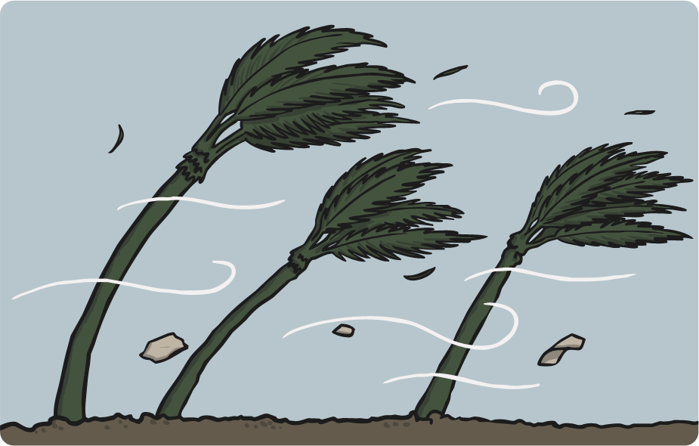
What’s the weather like there?
‘The Three Furnaces’ is a name referring to the hottest and most humid cities of China; Chongqing, Wuhan and Nanjing
China’s range of landscapes and environments are extremely vast, making the temperatures vary greatly across the country
Dry seasons and wet monsoons are quite typical

Slide 6
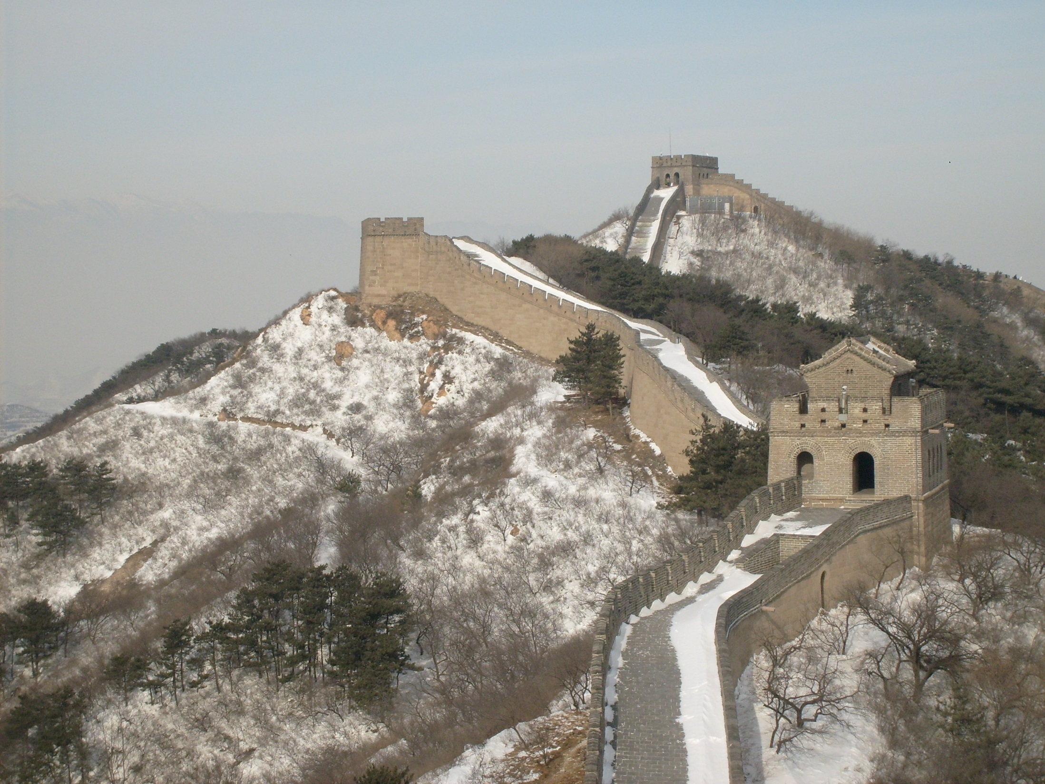
“Great Wall of China” by [inyucho] is licensed under CC BY 2.0

Slide 7
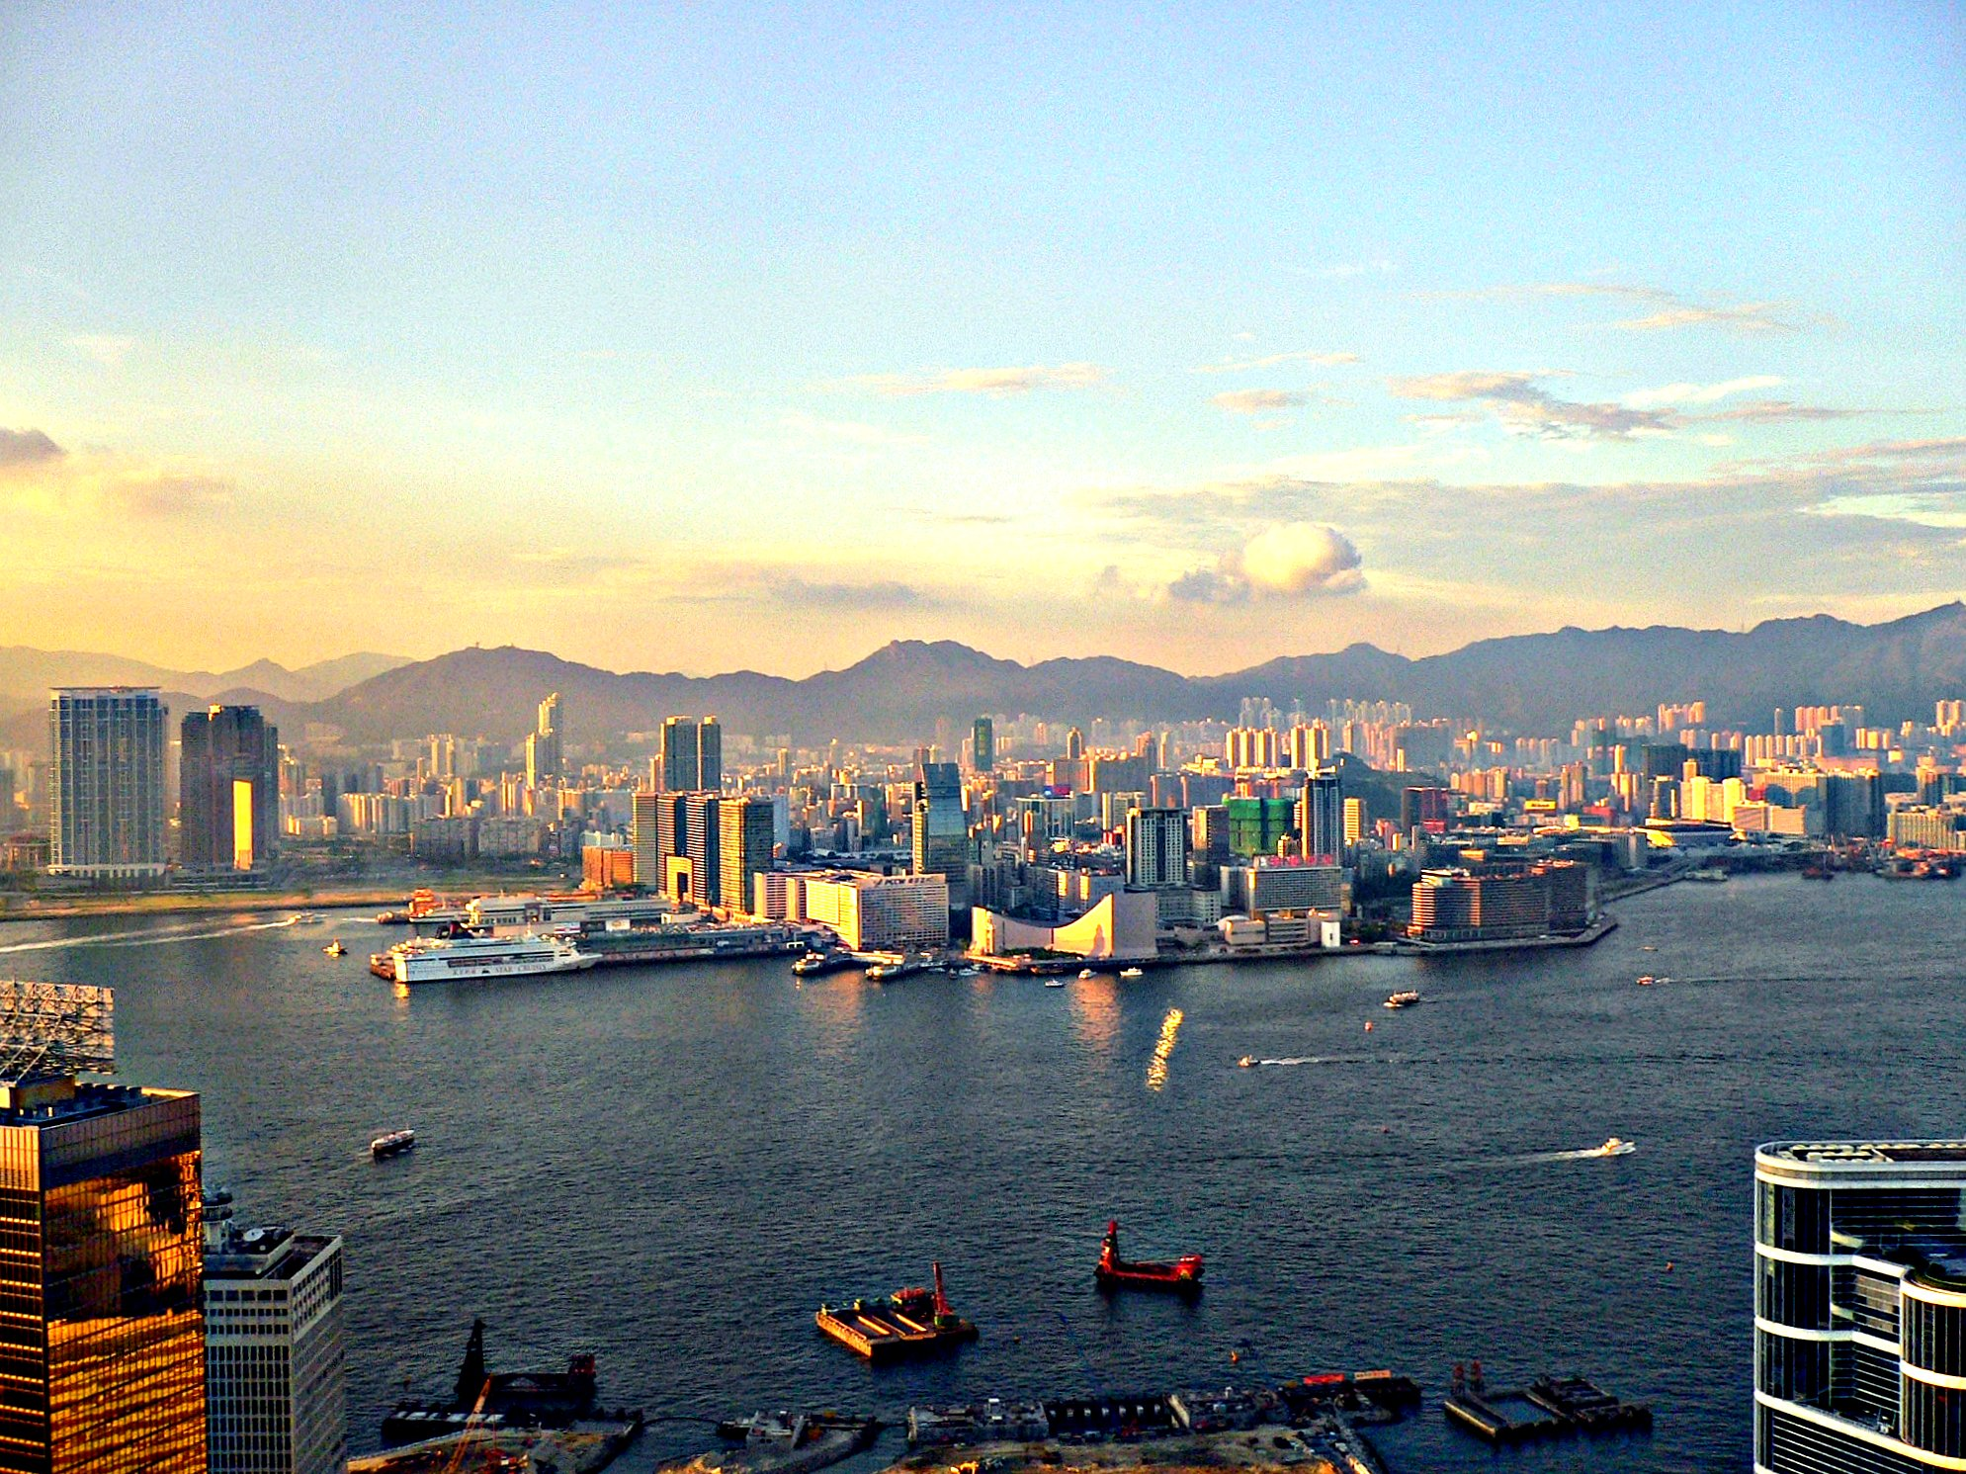
“China” by [HerryLawford] is licensed under CC BY 2.0

Slide 8
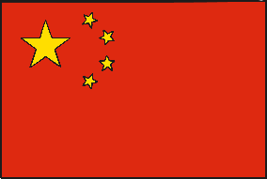
What would you like to learn about next?
Education
Food and Drink
Culture
KWL Grid
Plenary

Slide 9
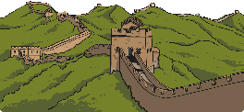
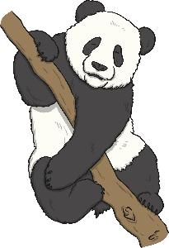
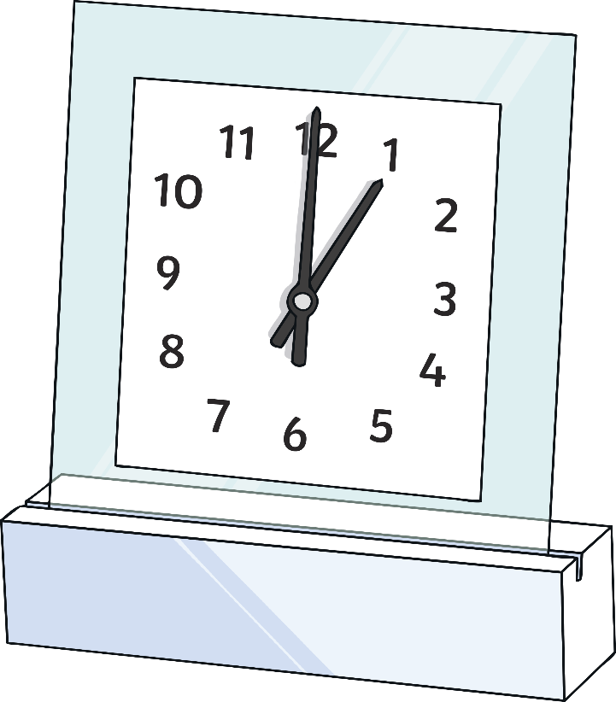
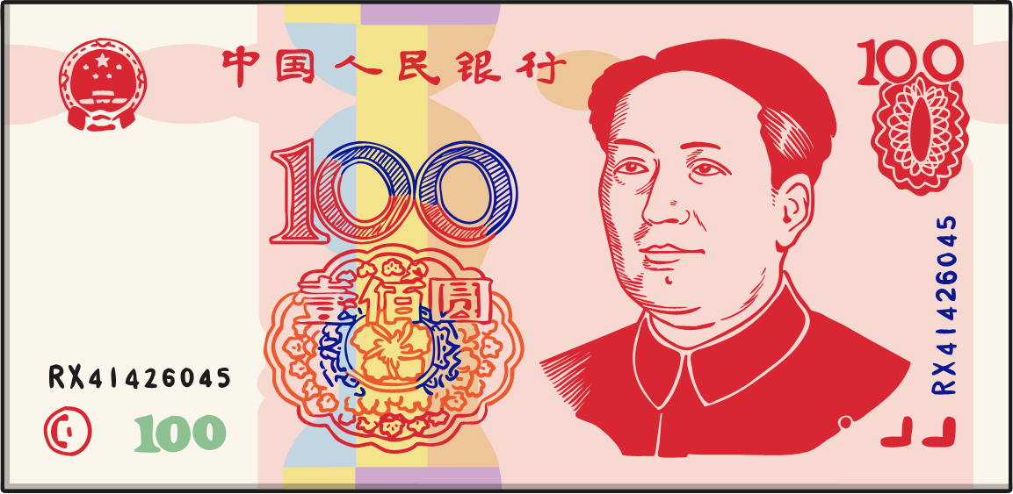
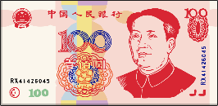
Culture
Though China technically runs through 5 time zones, the whole country actually runs on Beijing time, meaning that sunrise can happen as late as 10am in Western China.
The Giant Panda is native to China and all pandas found in different countries are loaned from China.
The currency used is the Chinese Yuan Renminbi (CNY, ¥).
Tickling was a form of torture in ancient China!
The great Wall of China is the largest man made structure in the world.
The official language of China is standard Mandarin, though there are many different Chinese dialects spoken all over the country.

Slide 10
KWL
What I already know | What I would like to know | What I know now

Slide 11
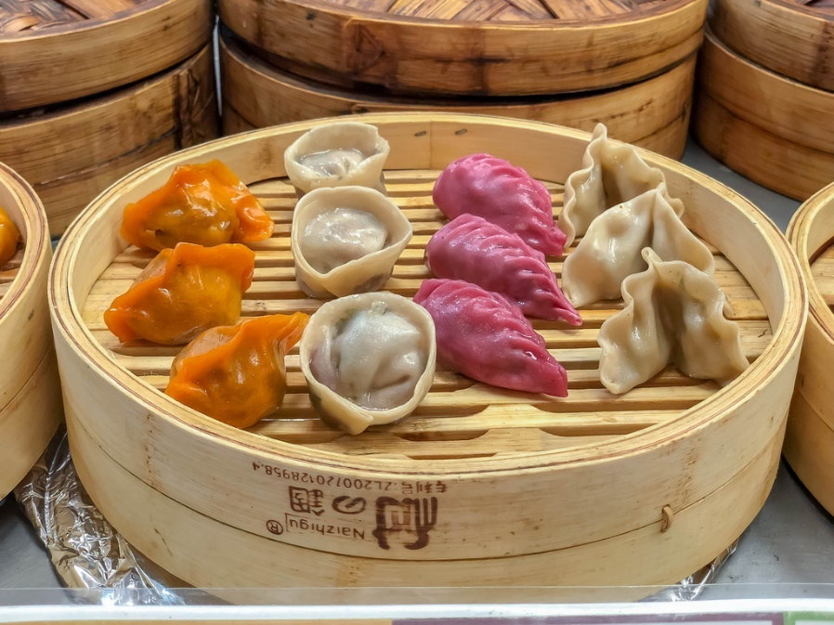
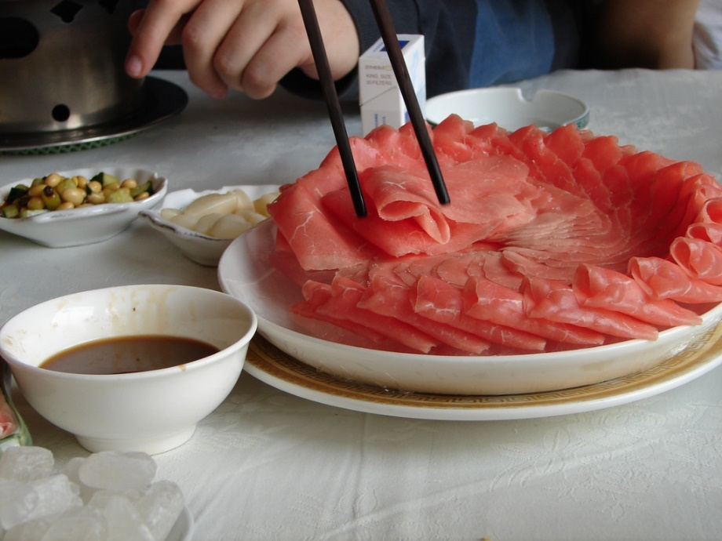
Food and Drink
Dim Sum: a collection of small dishes, some of which are dumplings and meat.
Chinese Hotpot: a meal where dishes of raw ingredients are cooked at the table in a pot of boiling broth.
“Dim Sum” by [marcoverch] is licensed under CC BY 2.0
“Chinese Hotpot” by [Helga's Lobster Stew] is licensed under CC BY 2.0

Slide 12
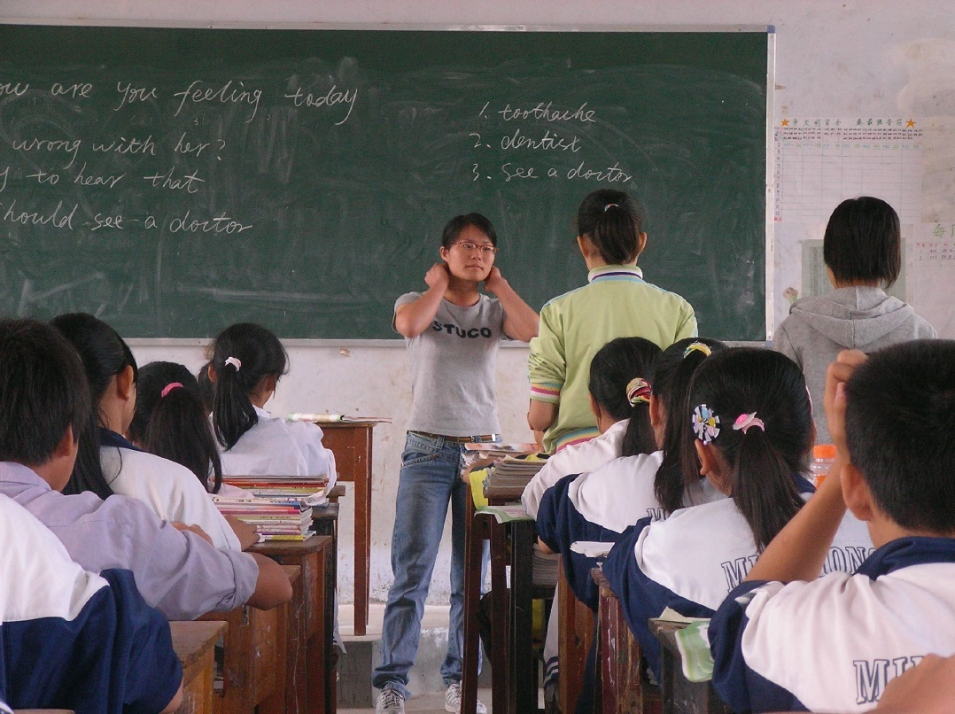
Education
China has a literacy rate of 95.1%.
Education is free and compulsory from ages 6 to 15.
Chinese compulsory education is made up of primary, middle and junior secondary school.

Slide 13
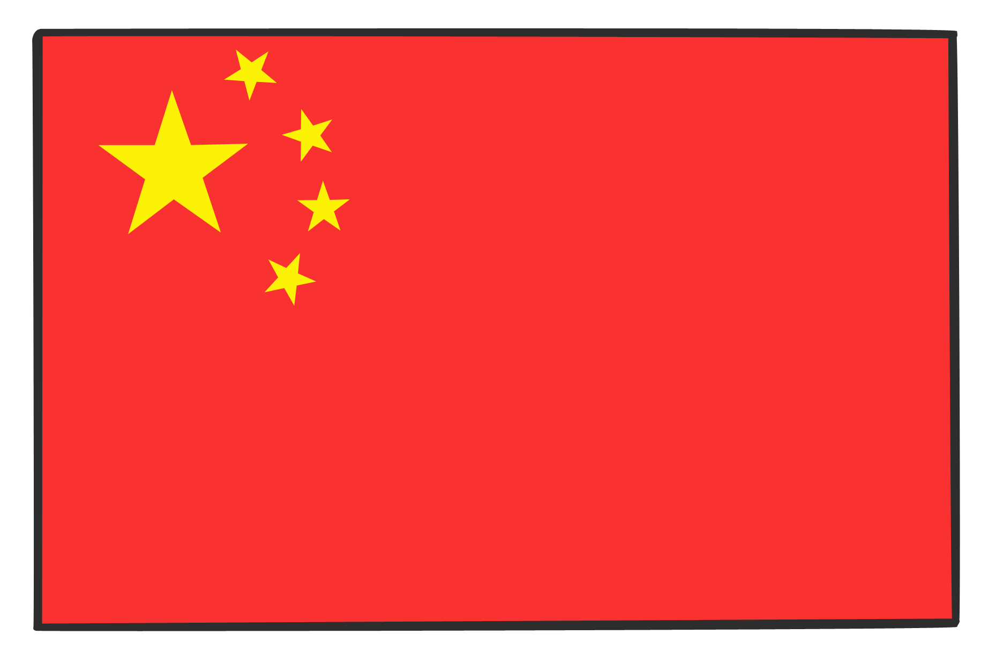
Plenary
Would you like to visit China? Why or why not?

